Slide 1
ADFv2 Demo
www.pwc.se
May 2019

Slide 2
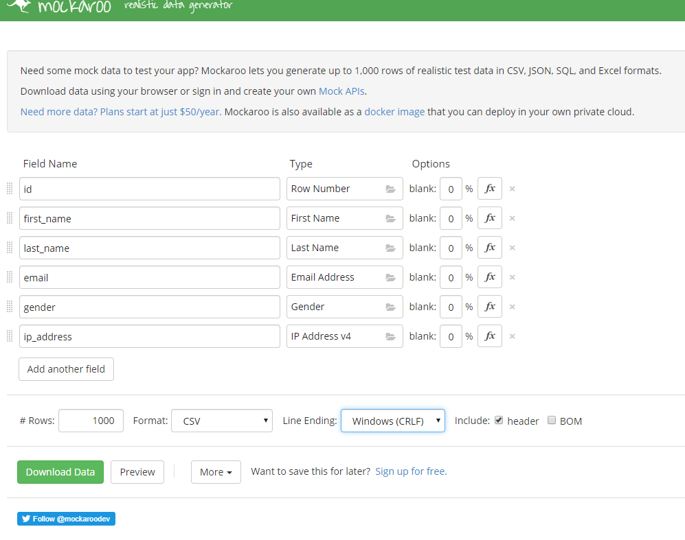
Generate Mock File

Slide 3
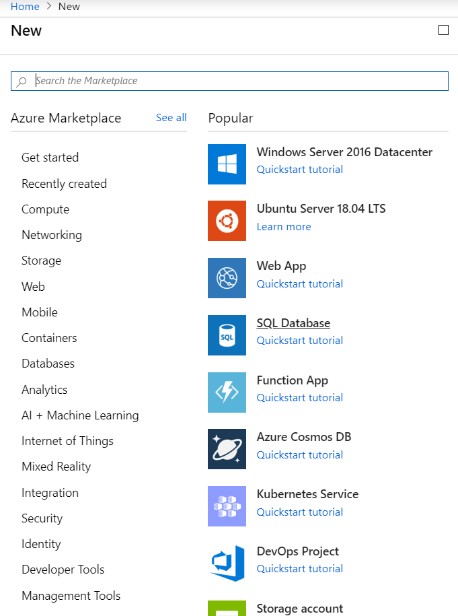
Add New Resource

Slide 4
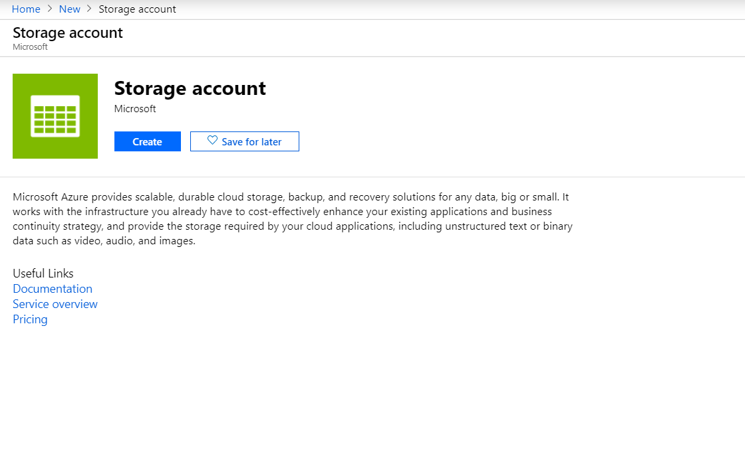
Add Storage Account

Slide 5
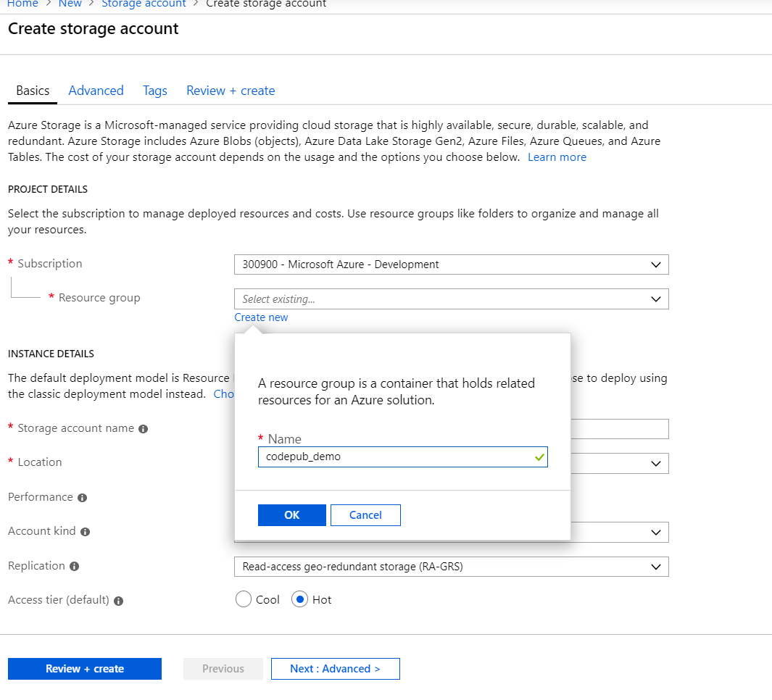
Create New Resource(One time)

Slide 6
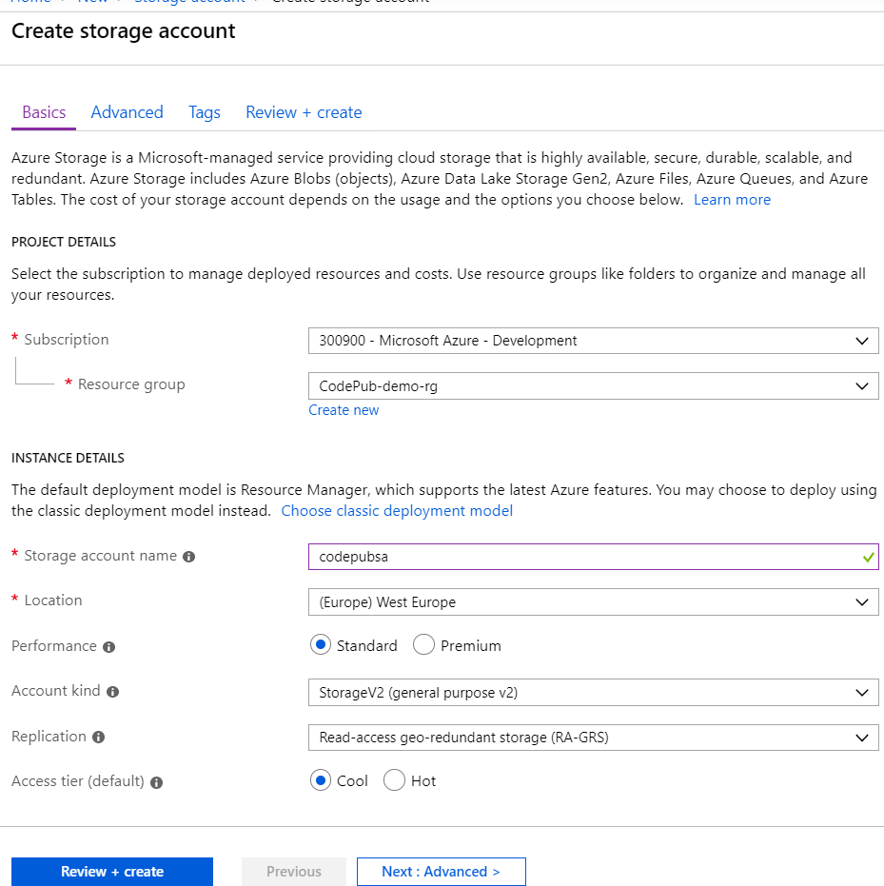
Add Storage Account details

Slide 7
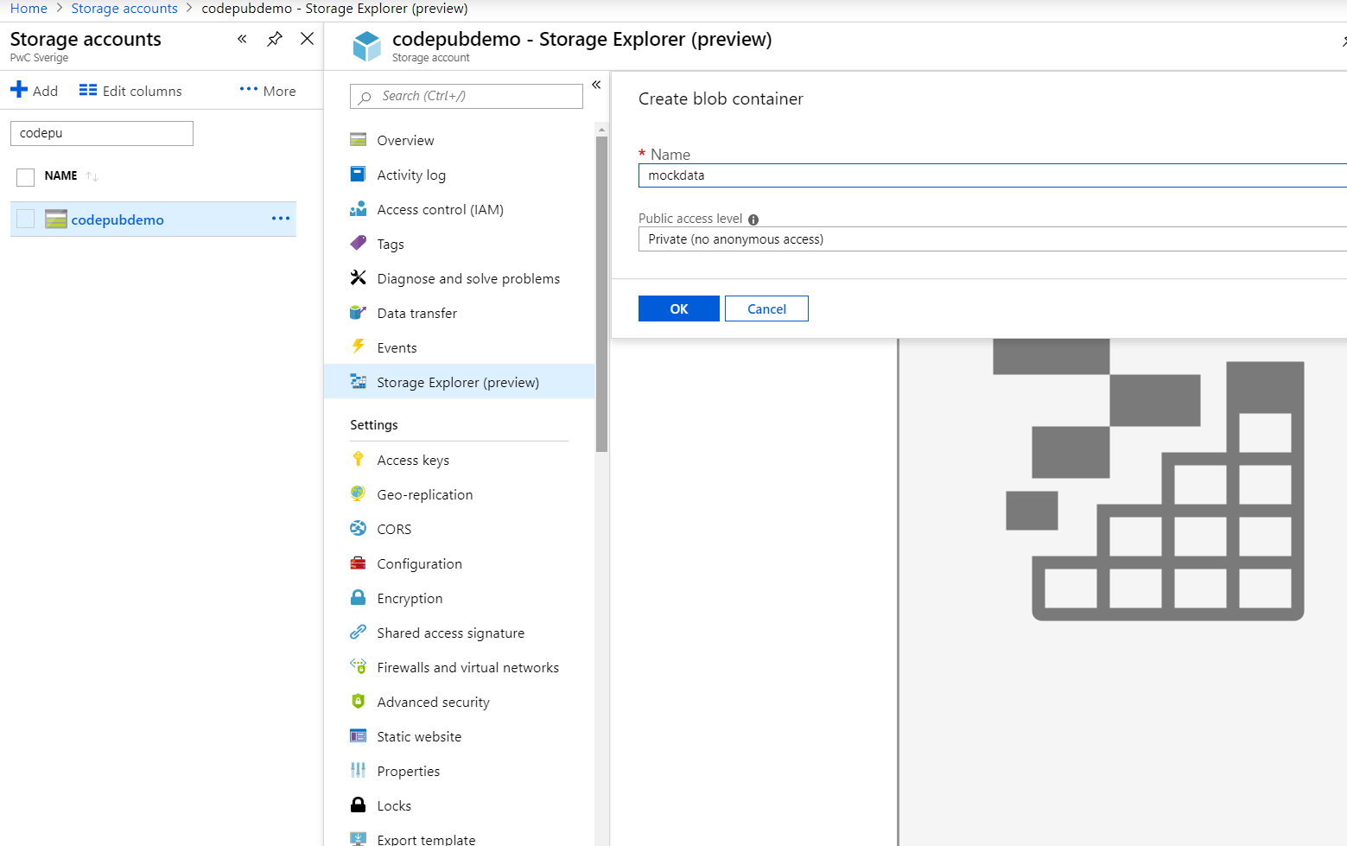
Add mocked file to Storage Account

Slide 8
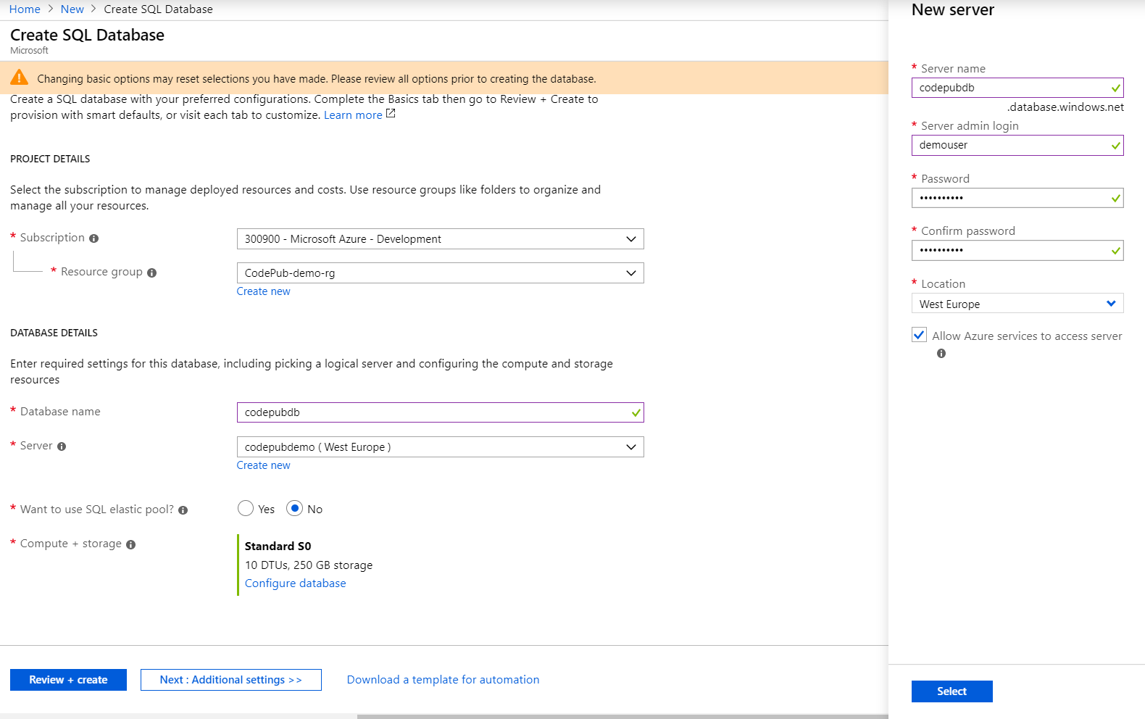
Add Sql Database (Create new server)

Slide 9
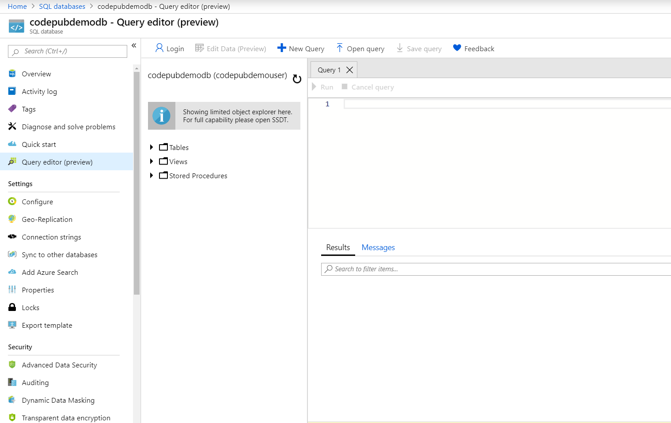
Add Table in Database

Slide 10
Sql query
CREATE TABLE MockPersonData (
Id int,
first_name varchar(255),
last_name varchar(255),
email varchar(100),
gender varchar(20),
ip_address varchar(100)
);

Slide 11
Sql Query
Create Table MetaData
(
updateddate Date
);
Insert Into MetaData (updateddate) values ('2019-05-07 13:02:49.147')

Slide 12
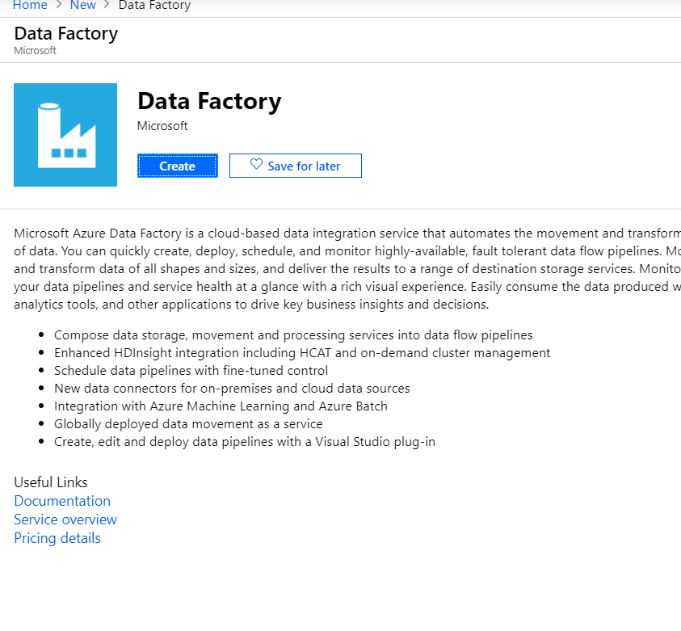
Add New Data Factory

Slide 13
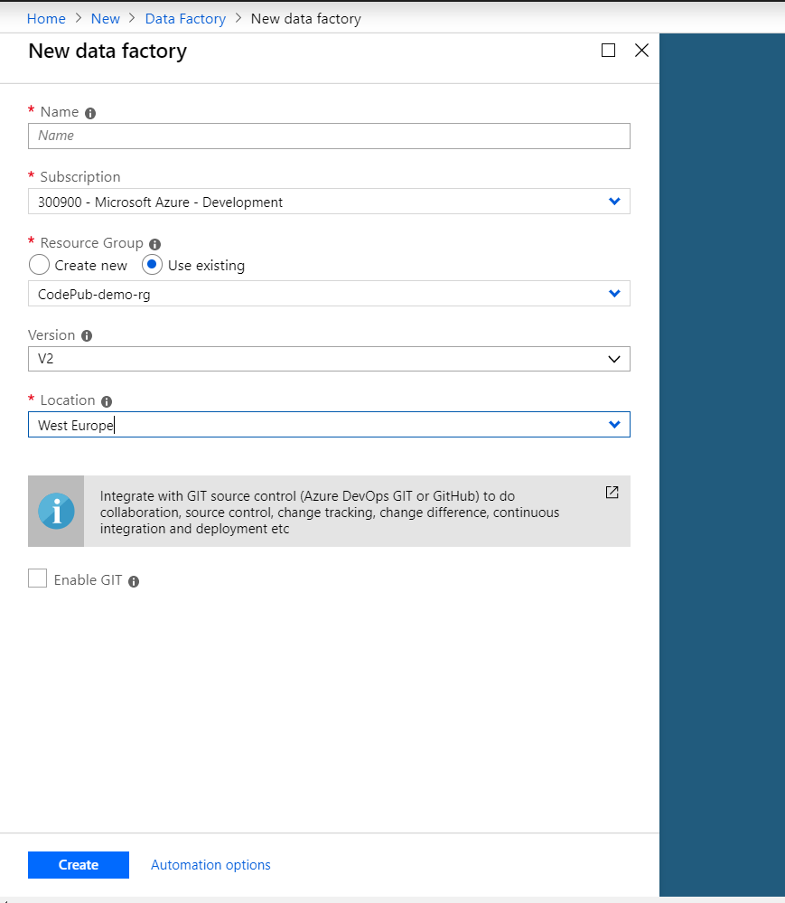
Add New Data Factory

Slide 14
Q&A

